Slide 1

SPORTS RUSH
A website for anything and everything related to sports i.e. training tutorials, blogs, news, dietetics and much more
Project by:
Ayush Wunnava 19BCT0181
Sarthak Gulati 19BCT0119

Slide 2
ACKNOWLEDGMENT
We would like to express my gratitude towards Ma’am Mareeswari V for guiding us throughout the project and allowing us to conduct SPORTS RUSH project.
I feel thankful to the college staff for giving me such a big opportunity. I believe I will enroll in more such events in the coming future. I ensure that this project was done by me and is not copied.
Ayush Wunnava 19BCT0181
Sarthak Gulati 19BCT0119

Slide 3
Inspiration behind the idea
The idea had a simple inspiration to provide a platform to people who like to open the second last page of the newspaper first thing in the morning.
The idea was to provide people who have major adrenaline rushes a platform that deals with everything related to sports i.e. ranging from the latest news to latest dietetics to tutorial videos from their favourite sport icons.
RUSH HOUR Blogs is created as a platform which is for the people by the people as a platform to voice their opinions and in the future we would like to make it up and running as a proper sports community media platform

Slide 4

AIM & SCOPE
The aim of our project is to build a Sports Network Community Website, which will broadly cover the following:
The highlights of recent sporting events.
The upcoming events like marathons, races etc.
Major news in various sports.
New diets and workout Smoothies.
Training Videos and Tutorials.
Blogs by the people for the people
The Scope of the website will cover a range of sports related information providing services
The people can beef up knowledge about sporting events, recent news.
Another functionality of the website is to provide tutorial videos for various sports.
The website also provides functionality regrading updating people with new and in trend diets and Workout smoothies.
The website aims at providing a community platform for sport-based influencers.
The website aims at providing a platform for presenting thoughts and news by the people for the people

Slide 5
Introduction
Sports is very essential part of a healthy lifestyle. It not only helps you be physically fit and strong but also improves your personality as whole. But in our busy lifestyles we often fail to realize his importance.
We at 'Sports Rush' aim to provide a single platform for everyone to stay updated with the sports World news and keep learning through it. This website doesn't just give news updates but also has more features like diet plans, training videos, interviews with the professionals, etc. which is very beneficial for people aspiring to be sports professionals.
This website will also provide you with information of any sports event happening around you for you to take part in just for fun.

Slide 6
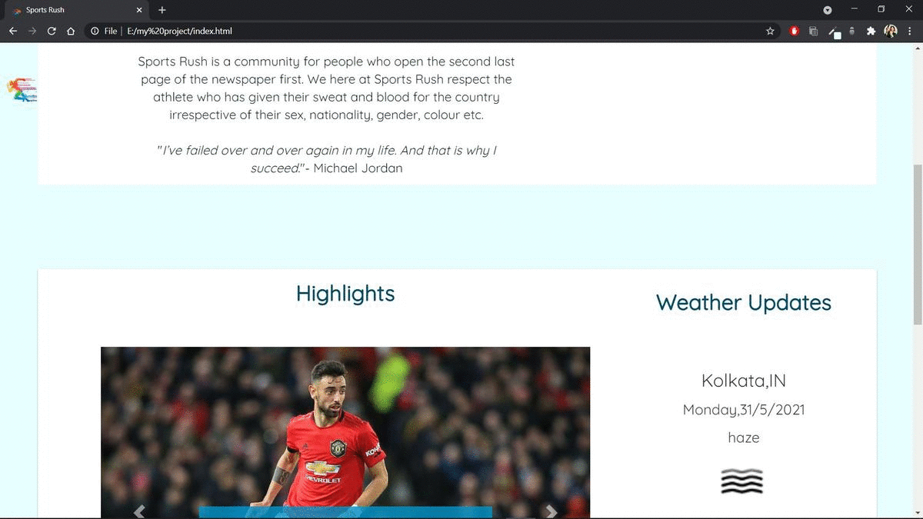
HOMEPAGE
The Home Page displays our motto and shows the recent highlights about Indian football, cricket and other sports which keep revolving and we can update them with recent trends and images.

Slide 7
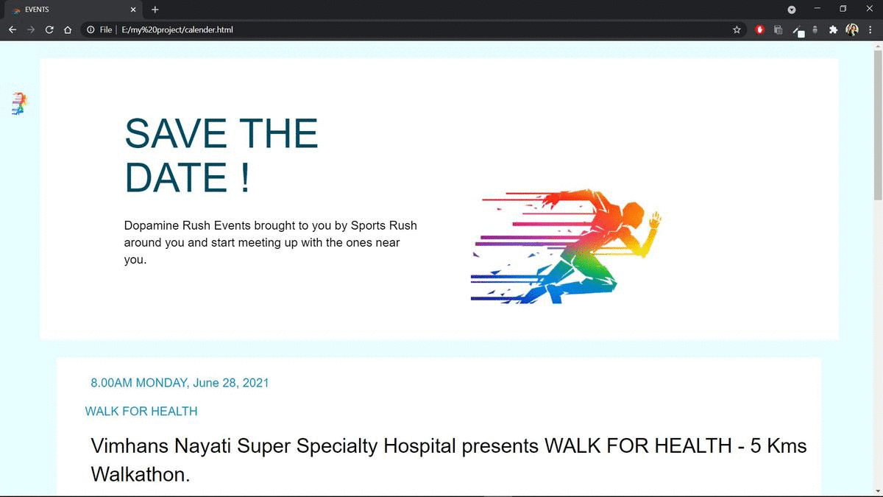
EVENTS
This section of the website displays the upcoming marathons, matches and other sporting events with all the information like contact number and other details about the information.

Slide 8
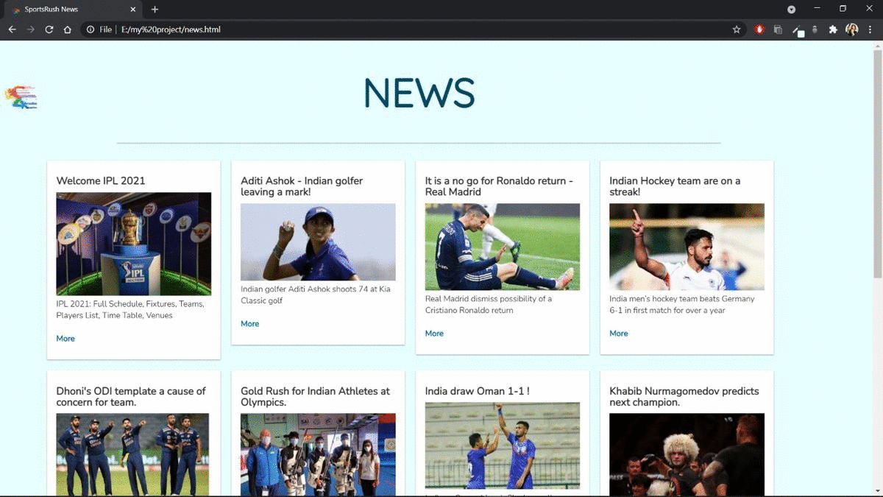
NEWS
This contains the latest news about Indian sports or important worldwide news with highlights and links to third party articles which are of sports interest.

Slide 9
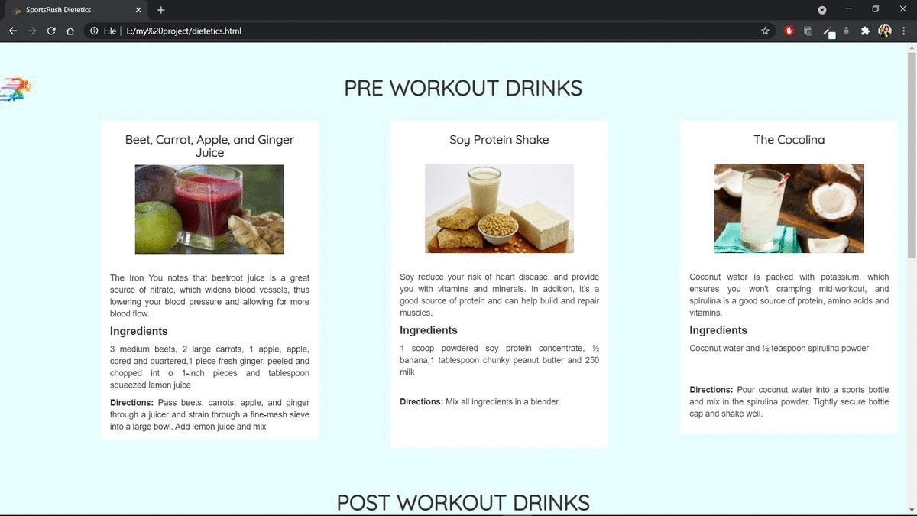
DIETETICS
This contains the new diets and workout drinks e.g., the Pre-Workout and Post-Workout drinks which can be used by people for their training purposes.

Slide 10
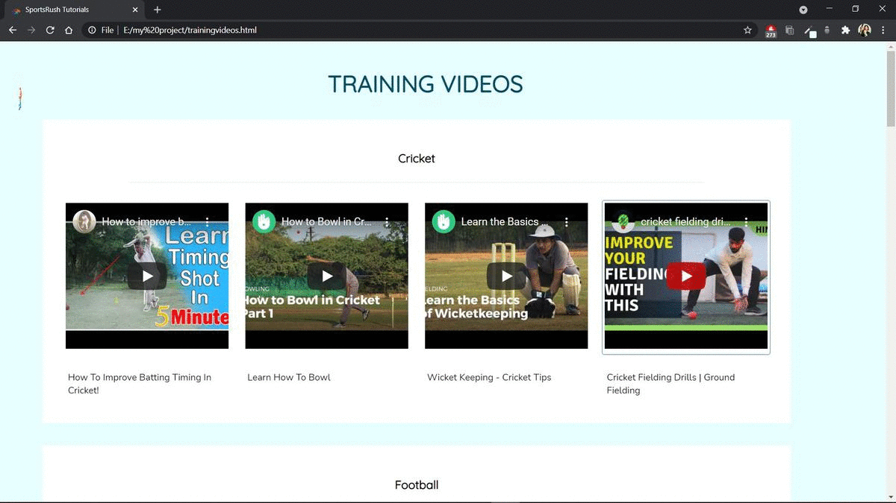
TRAINING TUTORIALS
This section contains tutorial videos of various sports like Cricket, Football, Basketball, badminton, Tennis with YouTube videos which play in the window.

Slide 11
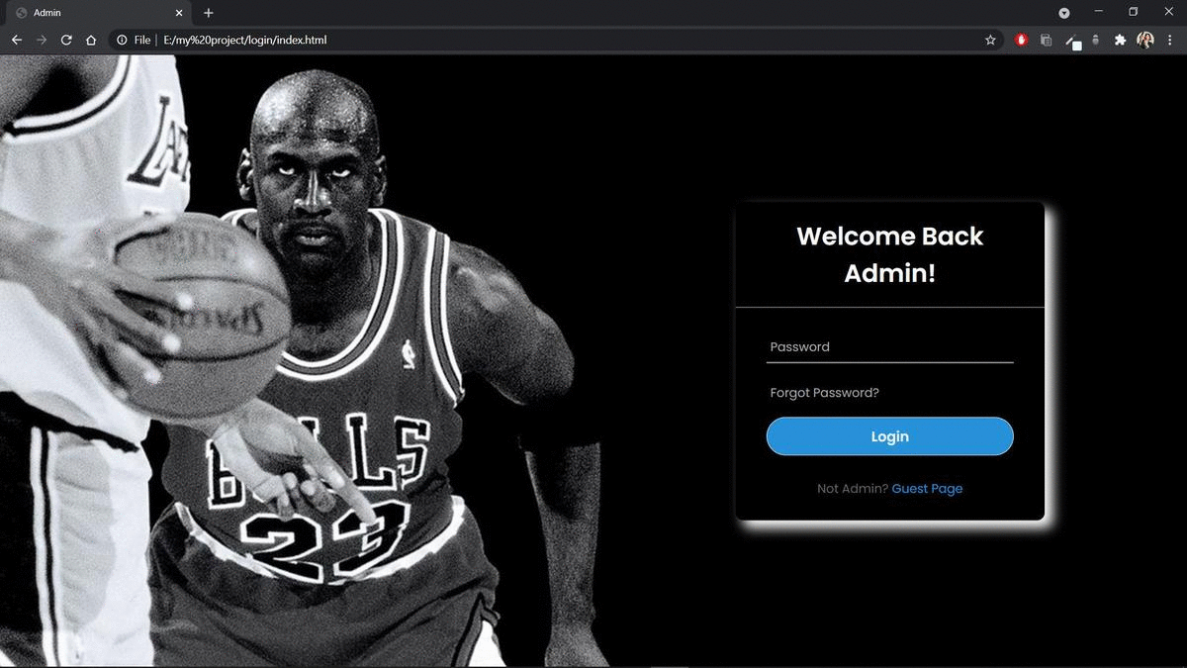
BLOG LOGIN

Slide 12
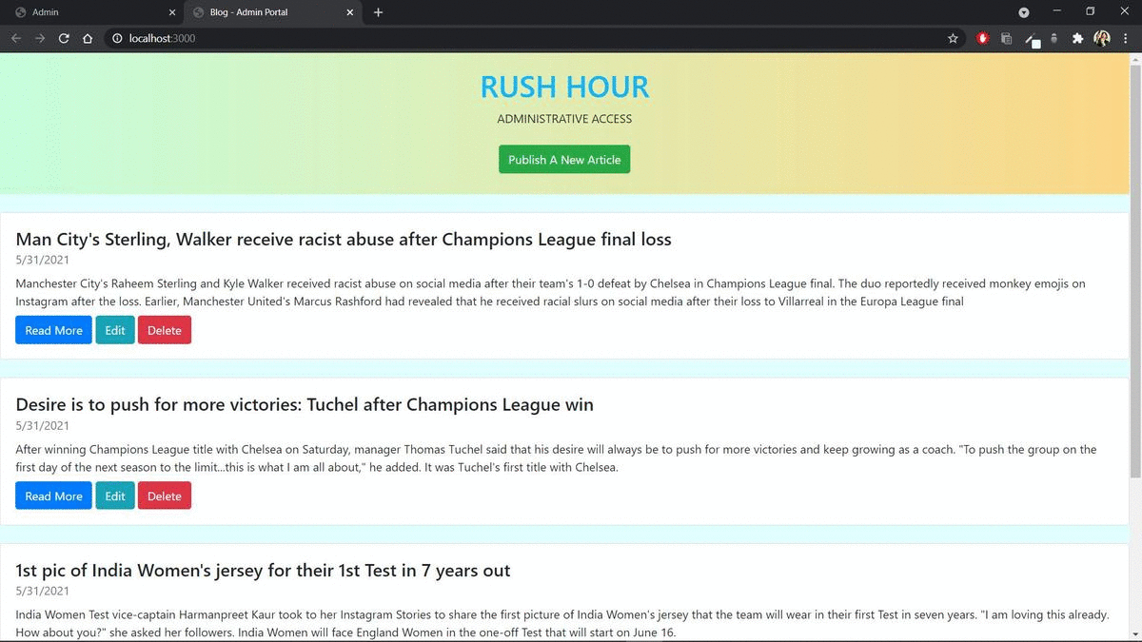
RUSH HOUR Blogs - ADMIN
This takes you to a login page which takes you the blog website where you can read or write and publish a blog.

Slide 13
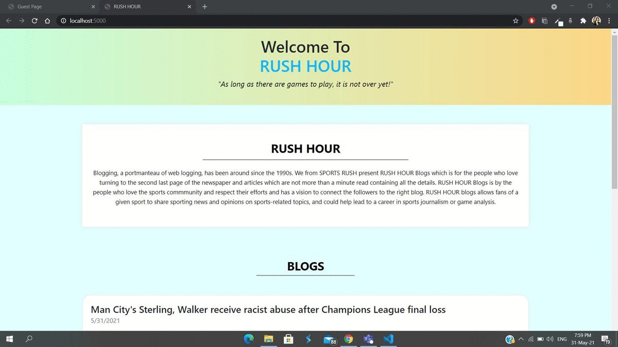
RUSH HOUR Blogs - GUEST

Slide 14
Conclusion & Future Enhancement
In conclusion, this is the basic plan for the “Sports Rush” Project. In future, the project will be completed and enhanced to include features such as linking maps to find routes TO and FRO major sports establishments in the city so that our application makes it easier for the user to form a community and explore the locality around them. Thus, making our application the one and only thing the consumer uses to communicate as all the information. Also, we have a vision to use the location detector and display the website and events accordingly to one’s geographic needs.
As the world advances in technology, we would also like to expand and make a community web app only for sport-based community influencing. The app will also have events hosting and inviting features. Groups can be created and events can be hosted for likeminded people with similar interests.
It is hoped that the program will be hence shortened and simplified but the basic structure will remain the same.

Slide 15
REFERENCES
How to Build a Simple Blog Using Node.js | Hacker Noon
Sports News: Cricket News, Football News & Tennis News in English with Inshorts
CSS Fonts (w3schools.com)
Basic Login System with Node.js, Express, and MySQL (codeshack.io)

Slide 16


